Slide 1
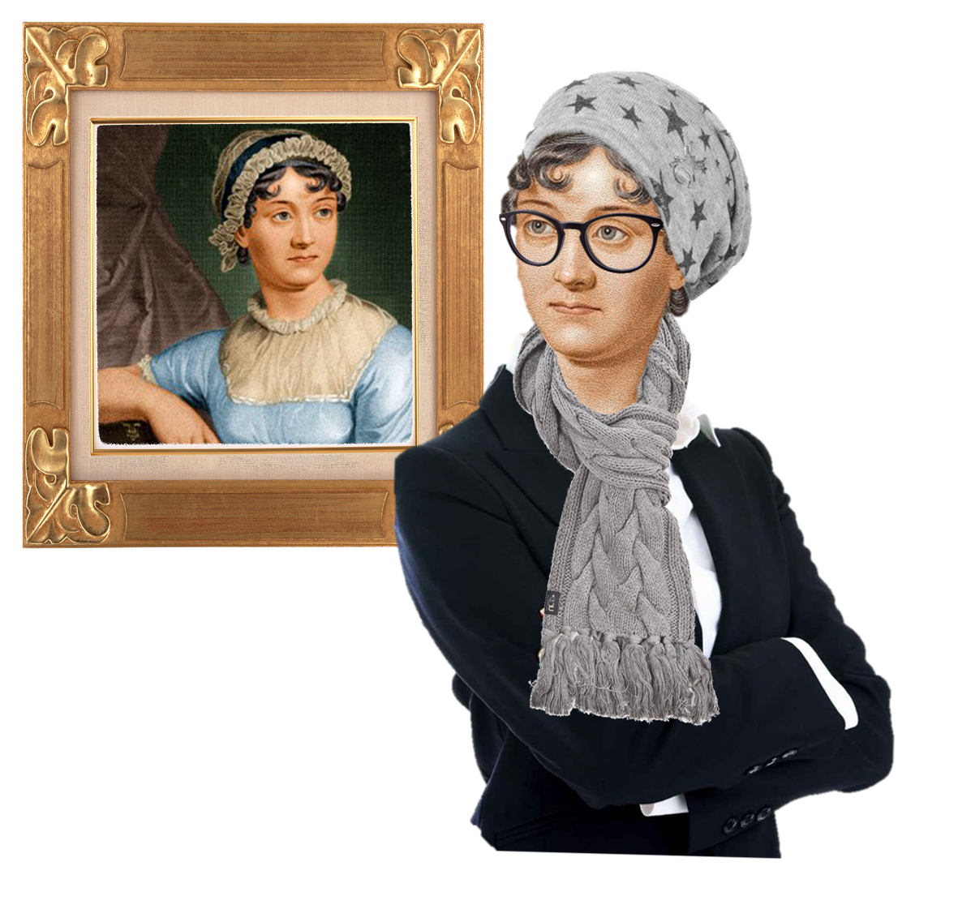
The Cultural Jane Austen
ENGL 481 – 904
Office Hours: Tuesday 12 – 1PM & Wednesdays 3 – 4 PM at LAAH 334
Ms. Kim myjungah92@tamu.edu

Slide 2
Table of Contents
Brief recap of last class
Copeland, Money
Proposal, Pride, & Prejudice
Darcy’s Letter
Narrative Intrusion

Slide 3
Character
All of [Pride and Prejudice’s] examples illustrate two different conceptions of character that coexist within Jane Austen: character as social being (a person is a character) and character as inner quality (a person has a character). The narrative structure that mediates between them is precisely asymmetry. Austen famously transforms the novel into a genre that abstracts elucidates, and diagnoses human characteristics: facilitating contrasts between inner qualities like “observation” and “temper.”
One vs the Many – Alex Woloch

Slide 4
Character defined by the OED
Moral and mental qualities strongly developed or strikingly displayed; distinct or distinguished personality.
The sum of the moral and mental qualities which distinguish an individual or a people, viewed as a homogeneous whole; a person's or group's individuality deriving from environment, culture, experience, etc.; mental or moral constitution, personality.
Personality, esp. strong personality, as suggested by an aspect of a person's appearance, or in a representation of a person.

Slide 5
Free Indirect Discourse (FID)
Free indirect discourse (FID) is a narrative technique in which the narrator’s third-person voice is infused with the first-person voice of the character without indicators, such as "she said" or "I thought.
The narrator has access to the thoughts and feelings of the characters and describes these to the reader. The narrator of the novel also frequently adds commentary about characters and their actions, which shapes the reader’s perception.
For example, at the start of the novel the narrator describes Mrs. Bennet as “a woman of mean understanding, little information, and uncertain temper.” Although the narrator has access to every character’s interior life, the novel’s events are usually told from Elizabeth’s point of view.

Slide 6
Effect of the FID
gossipy best friend = narrator
get part of the inside world
goes into the story
pulling the curtain back → familiar background in the polite society
how stories would be told verbally vs formal world
anecdotes

Slide 7
Thoughts on Copeland’s Money?

Slide 8
Copeland’s Money
It may, in fact, surprise some readers to know that Jane Austen does not write as a member of the landed gentry, or as a representative of the proprietors of such piles as Pemberley, Netherfield, Rosings, Norwood, Mansfield Park, Southerton, Donwell Abbey, Kellynch Hall, or any other of the imagined great houses of her novels, but as a member of a somewhat humbler rank that the historian David Spring calls the ‘pseudo-gentry’: that is, a group of upper professional families living in the country - clergyman or barristers, for example, or officers in the army and navy, retired rentiers, great merchants - allied by kinship and social ties, and by social aspirations as well, to their landed gentry neighbors, but different in an essential economic condition: they do not themselves possess the power and wealth invested in the ownership of land, but depend upon earned incomes.
Nevertheless, they are gentry of a sort, Spring notes wryly, ‘primarily because they sought strenuously to be taken for gentry’, through the acquisition if the manners, the education, and the same markers of station as their landed-gentry neighbours.
The consequence of such aspirations, however, presents this class with a two fold economic burden: first, of course, the need to pay for the necessary markers of their genteel appearance; and, second, the need to soften the inherent weakness of their economic position: with the loss of the breadwinner, there is the loss of his income as well.

Slide 9
Copeland’s Money
As a consequence, money, especially money as spendable income, is the love-tipped arrow aimed at the hearts of Jane Austen’s heroines and her readers: first of all, for its power to acquire the material goods that can support the all-important signs of her rank’s claims to genteel station; second, as the prod of anxiety that focuses its own potential for loss.
In her novels, Austen approaches the subject, money, from three different, but related, points of view:
First, as a member of the pseudo-gentry, that is to say, the upper-professional ranks of her rural society;
second, as a woman in that society; severely handicapped by law and custom from possessing significant power over money;
finally, as a novelist who joins other women novelists in a larger conversation about money.
And, as Jan Fergus reminds us in this volume, novel writing is itself an economic activity, with money the importunate force that moves this conversation along.

Slide 10
Copeland’s Money
In the more intimate, domestic negotiations of the novel, women’s fiction turns to the particular relationship that women have with money - that is, no legal title to it for married women, and rights severely curtailed for unmarried women.
In a frustrating social irony, the pseudo-gentry woman finds herself responsible for the management of the household, but prevented by law and custom from exercising any significant control over the management of the family’s income, a male prerogative.
If money affairs go badly, as they certainly will with a feckless, foolish, improvident man like Willoughby, or with an out-and-out scoundrel like Wickham, the woman is still responsible for the economic circumstances, a victim herself of course, but still responsible.
From the start of her career, Austen is a shrewd observer of the economic terrain of her class, though always from the chilly and exposed position of an economically marginal female member of it - herself related to the landed gentry through the good fortune of her brother Edward (adopted by wealthy gentry relations), but really no more than a maiden-aunt visitor to his estate and his class.
In fact, the shadow of the single woman without money, Charlotte Lucas syndrome, continues to haunt her works to the end.
But in each of these later novels, the ‘case’ regularly falls short before the immovable plight of the single woman without money. Fanny Price, Jane Fairfax, even Anne Elliot, are, in the end, left dependant upon the purest chance for their entrance into the monied world of the ‘case.’
Moreover, the moral identity of each one of these women must first be asserted against the economic ‘case’ that eventually defines her social identity.

Slide 11
Money & Management
more specific detail on the different amount of money = different classes - depending on the characters
Mr. & Mrs. Bennet’s idea on money is different from other gentry
Lack of education/management may also be the cause in managing their household

Slide 12
Important passages

Slide 13
Pride, Prejudice, & Proposal

Slide 14
But why Mr. Darcy? & Charlotte’s Imagination
But why Mr. Darcy came so often to the Parsonage it was more difficult to understand. It could not be for society, as he frequently sat there ten minutes together without opening his lips; and when he did speak, it seemed the effect of necessity rather than of choice—a sacrifice to propriety, not a pleasure to himself. He seldom appeared really animated. Mrs. Collins knew not what to make of him. Colonel Fitzwilliam’s occasionally laughing at his stupidity proved that he was generally different, which her own knowledge of him could not have told her; and as she would have liked to believe this change the effect of love, and the object of that love her friend Eliza, she set herself seriously to work to find it out: she watched him whenever they were at Rosings, and whenever he came to Hunsford; but without much success. He certainly looked at her friend a great deal, but the expression of that look was disputable. It was an earnest, steadfast gaze, but she often doubted whether there were much admiration in it, and sometimes it seemed nothing but absence of mind. (p.176, Oxford p.136)
Discussion Question: Why is it Charlotte that is observing this?

Slide 15
Family Influence
“There were some very strong objections against the lady,” were Colonel Fitzwilliam’s words; and these strong objections probably were, her having one uncle who was a country attorney, and another who was in business in London.
“To Jane herself,” she exclaimed, “there could be no possibility of objection,—all loveliness and goodness as she is! Her understanding excellent, her mind improved, and her manners captivating. Neither could anything be urged against my father, who, though with some peculiarities, has abilities which Mr. Darcy himself need not disdain, and respectability which he will probably never reach.” When she thought of her mother, indeed, her confidence gave way a little; but she would not allow that any objections there had material weight with Mr. Darcy, whose pride, she was convinced, would receive a deeper wound from the want of importance in his friend’s connections than from their want of sense; and she was quite decided, at last, that he had been partly governed by this worst kind of pride, and partly by the wish of retaining Mr. Bingley for his sister. (p.182, Oxford p. 139)
Discussion Question: What are the burdens of the Bennet family?

Slide 16
Proposal Scenes
2005 FILM https://www.youtube.com/watch?v=yBqyLoWtYg8
BBC DRAMA https://www.youtube.com/watch?v=JF3ueHjUc3k
Bridget Jones Diary (watch on your own later!): https://www.youtube.com/watch?v=1QJdRgMLCiE

Slide 17
The Second Proposal
In a hurried manner he immediately began an inquiry after her health, imputing his visit to a wish of hearing that she were better. She answered him with cold civility. He sat down for a few moments, and then getting up walked about the room. Elizabeth was surprised, but said not a word. After a silence of several minutes, he came towards her in an agitated manner, and thus began:—
“In vain have I struggled. It will not do. My feelings will not be repressed. You must allow me to tell you how ardently I admire and love you.”
Elizabeth’s astonishment was beyond expression. She stared, coloured, doubted, and was silent. This he considered sufficient encouragement, and the avowal of all that he felt and had long felt for her immediately followed. He spoke well; but there were feelings besides those of the heart to be detailed, and he was not more eloquent on the subject of tenderness than of pride. His sense of her inferiority, of its being a degradation, of the family obstacles which judgment had always opposed to inclination, were dwelt on with a warmth which seemed due to the consequence he was wounding, but was very unlikely to recommend his suit.
(p.185, Oxford p.142 - 143)
Discussion Question: In what ways is dramatism produced in this proposal? How does it compare to Mr. Collins’ proposal?
Pride vs Pride (Elizabeth & Darcy)
Insulted her family = Darcy
Narrator intrusion => interpreting for us on how rude Darcy may have been

Slide 18
Sorry for the pain she was about to cause
In spite of her deeply-rooted dislike, she could not be insensible to the compliment of such a man’s affection, and though her intentions did not vary for an instant, she was at first sorry for the pain he was to receive; till roused to resentment by his subsequent language, she lost all compassion in anger. She tried, however, to compose herself to answer him with patience, when he should have done. He concluded with representing to her the strength of that attachment which in spite of all his endeavours he had found impossible to conquer; and with expressing his hope that it would now be rewarded by her acceptance of his hand. As he said this she could easily see that he had no doubt of a favourable answer. He spoke of apprehension and anxiety, but his countenance expressed real security. Such a circumstance could only exasperate farther; and when he ceased the colour rose into her cheeks and she said,— (Oxford p. 143)
Discussion Question: What kinds of misunderstandings are embedded in their wording?
Verbal vs Letter [Darcy lacks eloquence verbal language due to gender / Darcy is very passionate about poetry / when he thinks of a romantic pursuit / thinks about literature in written language]

Slide 19
Elizabeth’s Second Rejection
“In such cases as this, it is, I believe, the established mode to express a sense of obligation for the sentiments avowed, however unequally they may be returned. It is natural that obligation should be felt, and if I could feel gratitude, I would now thank you. But I cannot—I have never desired your good opinion, and you have certainly bestowed it most unwillingly. I am sorry to have occasioned pain to anyone. It has been most unconsciously done, however, and I hope will be of short duration. The feelings which you tell me have long prevented the acknowledgment of your regard can have little difficulty in overcoming it after this explanation.” (p.185, Oxford p. 142)
Discussion Question: In what ways is her rejection different from how she rejected Mr. Collins?

Slide 20
Romantic Offense
“I might as well inquire,” replied she, “why, with so evident a design of offending and insulting me, you chose to tell me that you liked me against your will, against your reason, and even against your character? Was not this some excuse for incivility, if I was uncivil? But I have other provocations. You know I have. Had not my own feelings decided against you, had they been indifferent, or had they even been favourable, do you think that any consideration would tempt me to accept the man who has been the means of ruining, perhaps for ever, the happiness of a most beloved sister?”
As she pronounced these words, Mr. Darcy changed colour; but the emotion was short, and he listened without attempting to interrupt her while she continued,— (186, Oxford p. 143)
Discussion Question: Why does Elizabeth say in so much detail about her rejection on what he thinks?
very direct with her own words/no need for translation as opposed to Darcy [speaking out his mind, but in a convoluted manner]
Darcy ⇒ I can never love you but here is why / unintentionally giving the opportunity / more of defending the reason

Slide 21
Explosive Feelings
“From the very beginning, from the first moment, I may almost say, of my acquaintance with you, your manners impressing me with the fullest belief of your arrogance, your conceit, and your selfish disdain of the feelings of others, were such as to form that groundwork of disapprobation, on which succeeding events have built so immovable a dislike; and I had not known you a month before I felt that you were the last man in the world whom I could ever be prevailed on to marry. (p.188, Oxford p.145)
Discussion Question: Why is she so harsh with her rejection to Mr. Darcy?

Slide 22
Darcy’s Letter

Slide 23
The effect of Darcy’s Letter?
Why does he confess his secrets to her in a letter?

Slide 24
Letter Writing
Darcy is not allowed to love and I am not allowed to love him = Elizabeth
Elizabeth allows letters to be the means of communication
A person who does not show his emotions readily = Mr. Darcy
Verbally = people don’t understand his emotions / saying it but not showing it
Expression = say it with feeling - Mr. Darcy cannot, but through the letter / Him saying it in a different tone / She can understand him more
Using the form of letter = gives him the opportunity of rejecting from afar
Jane Austen version of communicating big feelings / gives the person space/time
Gives him time to figure out his own feelings / Writing becomes a means of understanding
Spectrum of Autism for Darcy [write out / feel out his feelings]

Slide 25
Excitement of Feeling through Letters
ELIZABETH, when Mr. Darcy gave her the letter, did not expect it to contain a renewal of his offers, she had formed no expectation at all of its contents. But such as they were, it may be well supposed how eagerly she went through them, and what a contrariety of emotion they excited. Her feelings as she read were scarcely to be defined. With amazement did she first understand that he believed any apology to be in his power; and steadfastly was she persuaded, that he could have no explanation to give, which a just sense of shame would not conceal. With a strong prejudice against everything he might say, she began his account of what had happened at Netherfield. She read with an eagerness which hardly left her power of comprehension; and from impatience of knowing what the next sentence might bring, was incapable of attending to the sense of the one before her eyes. His belief of her sister’s insensibility she instantly resolved to be false; and his account of the real, the worst objections to the match, made her too angry to have any wish of doing him justice. He expressed no regret for what he had done which satisfied her; his style was not penitent, but haughty. It was all pride and insolence (198, p. 152 - 153)
Discussion Question: Does Elizabeth secretly like Mr. Darcy?

Slide 26
Elizabeth’s Pride & Prejudice
In this perturbed state of mind, with thoughts that could rest on nothing, she walked on; but it would not do: in half a minute the letter was unfolded again; and collecting herself as well as she could, she again began the mortifying perusal of all that related to Wickham, and commanded herself so far as to examine the meaning of every sentence. The account of his connection with the Pemberley family was exactly what he had related himself; and the kindness of the late Mr. Darcy, though she had not before known its extent, agreed equally well with his own words. So far each recital confirmed the other; but when she came to the will, the difference was great. What Wickham had said of the living was fresh in her memory; and as she recalled his very words, it was impossible not to feel that there was gross duplicity on one side or the other, and, for a few moments, she flattered herself that her wishes did not err. But when she read and re-read, with the closest attention, the particulars immediately following of Wickham’s resigning all pretensions to the living, of his receiving in lieu so considerable a sum as three thousand pounds, again was she forced to hesitate. She put down the letter, weighed every circumstance with what she meant to be impartiality—deliberated on the probability of each statement—but with little success. On both sides it was only assertion. Again she read on. But every line proved more clearly that the affair, which she had believed it impossible that any contrivance could so represent as to render Mr. Darcy’s conduct in it less than infamous, was capable of a turn which must make him entirely blameless throughout the whole. (199, Oxford p. 153 - 154)
Discussion Question: Why is this narrative told in FID?
talking about her own prejudice / seeing a filter on his letter / emotions seem to calm down / maybe he is telling the truth vs how I feel
Fine line between love & hate / she feels something and disguises it / in reality has her own feelings (inspite of that)
Both feel the pressures of society / Elephant in the room because it will make other people upset
Darcy = rank matters / Elizabeth = self-respect / family

Slide 27
Prejudice & Self Reflection
She grew absolutely ashamed of herself. Of neither Darcy nor Wickham could she think, without feeling that she had been blind, partial, prejudiced, absurd.
“How despicably have I acted!” she cried. “I, who have prided myself on my discernment! I, who have valued myself on my abilities! who have often disdained the generous candour of my sister, and gratified my vanity in useless or blameless distrust. How humiliating is this discovery! Yet, how just a humiliation! Had I been in love, I could not have been more wretchedly blind. But vanity, not love, has been my folly. Pleased with the preference of one, and offended by the neglect of the other, on the very beginning of our acquaintance, have courted prepossession and ignorance, and driven reason away where either were concerned. Till this moment, I never knew myself.” (p.201, Oxford p.155 - 156)
Discussion Question: Why is this told in first person? Why is it in dialogue?

Slide 28
Mr. Darcy’s Letter
Mr. Darcy’s letter she was in a fair way of soon knowing by heart. She studied every sentence; and her feelings towards its writer were at times widely different. When she remembered the style of his address, she was still full of indignation: but when she considered how unjustly she had condemned and upbraided him, her anger was turned against herself; and his disappointed feelings became the object of compassion. His attachment excited gratitude, his general character respect: but she could not approve him; nor could she for a moment repent her refusal, or feel the slightest inclination ever to see him again. In her own past behaviour, there was a constant source of vexation and regret: and in the unhappy defects of her family, a subject of yet heavier chagrin. (Oxford p.159)
Discussion Question: Why does she keep re-reading the letter? What significance does the letter hold, as a material object?
different from everyone else / interested in him / justifying him to herself
Darcy is a hard person to understand / Letter = he actually makes sense / Letter validates him
The more she reads it, she likes him

Slide 29
Narrative Intrusion

Slide 30
Narrator’s Commentary
Anxiety on Jane’s behalf was another prevailing concern; and Mr. Darcy’s explanation, by restoring Bingley to all her former good opinion, heightened the sense of what Jane had lost. His affection was proved to have been sincere, and his conduct cleared of all blame, unless any could attach to the implicitness of his confidence in his friend. How grievous then was the thought that, of a situation so desirable in every respect, so replete with advantage, so promising for happiness, Jane had been deprived, by the folly and indecorum of her own family! (207, Oxford p. 159 - 160)
Discussion Question: What do we make of the narrative voice here?
logical commentary / Elizabeth is so involved
Objective perspective / Jane lost a lot → due to her own family

