Slide 1
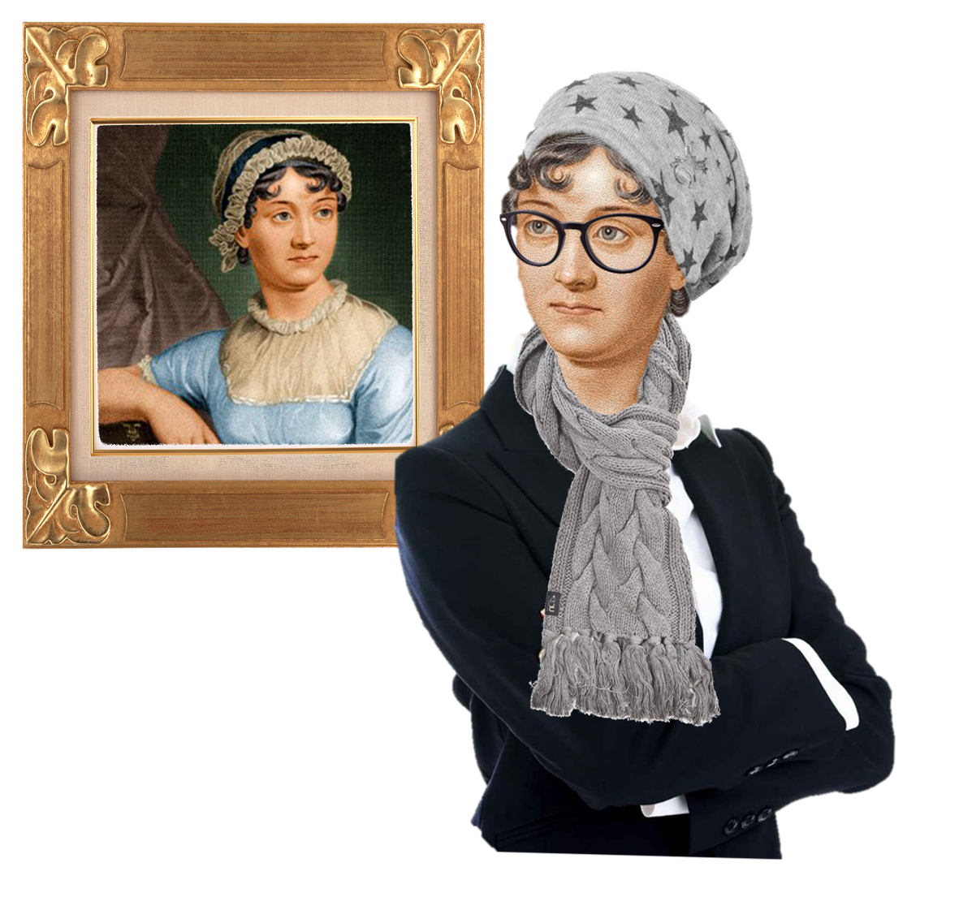
The Cultural Jane Austen
ENGL 481 – 904
Office Hours: Tuesday 12 – 1PM & Wednesdays 3 – 4 PM at LAAH 334
Ms. Kim myjungah92@tamu.edu

Slide 2
Table of Contents
Brief recap of last class
Keymer, On Rank
Small Group Discussion
Large Group Discussion

Slide 3
Why are Jane Austen Adaptations so relevant?
Relevant to today’s society for:
Double Standards of Education between Men and Women in Education
The Romance & The Plot
Class Issues
Realistic characters

Slide 4
Reasons
slowness of romantic plot
satire/wit from narratives
romantic plots just in general that you can relate to
the eloquence of the story / satire [done so eloquently]
classiness of how she describes things [similar to rom-coms]
social class [backdoors to certain points about things]
social status in breakfast manners even
etiquette/manner
blunt language
draws on the irony of the situation
space for women’s lives [not super dominated in male’s lives]

Slide 5
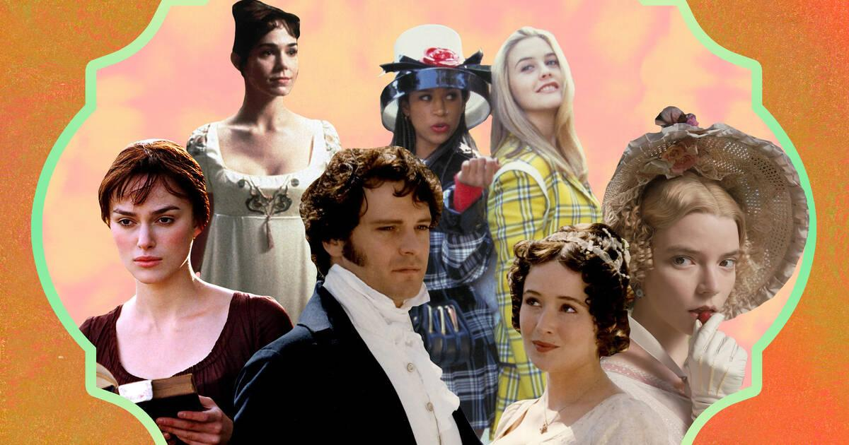

Slide 6
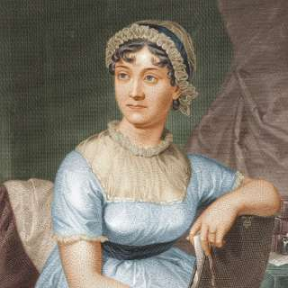
Historical Timeline
1792, A Vindication of Women’s Rights got Published
1796 – 1797 – Austen wrote ‘First Impressions’, a first version of Pride and Prejudice
1802 Austen accepted a proposal of marriage from Harris Bigg Wither, but changed her mind the following day

Slide 7
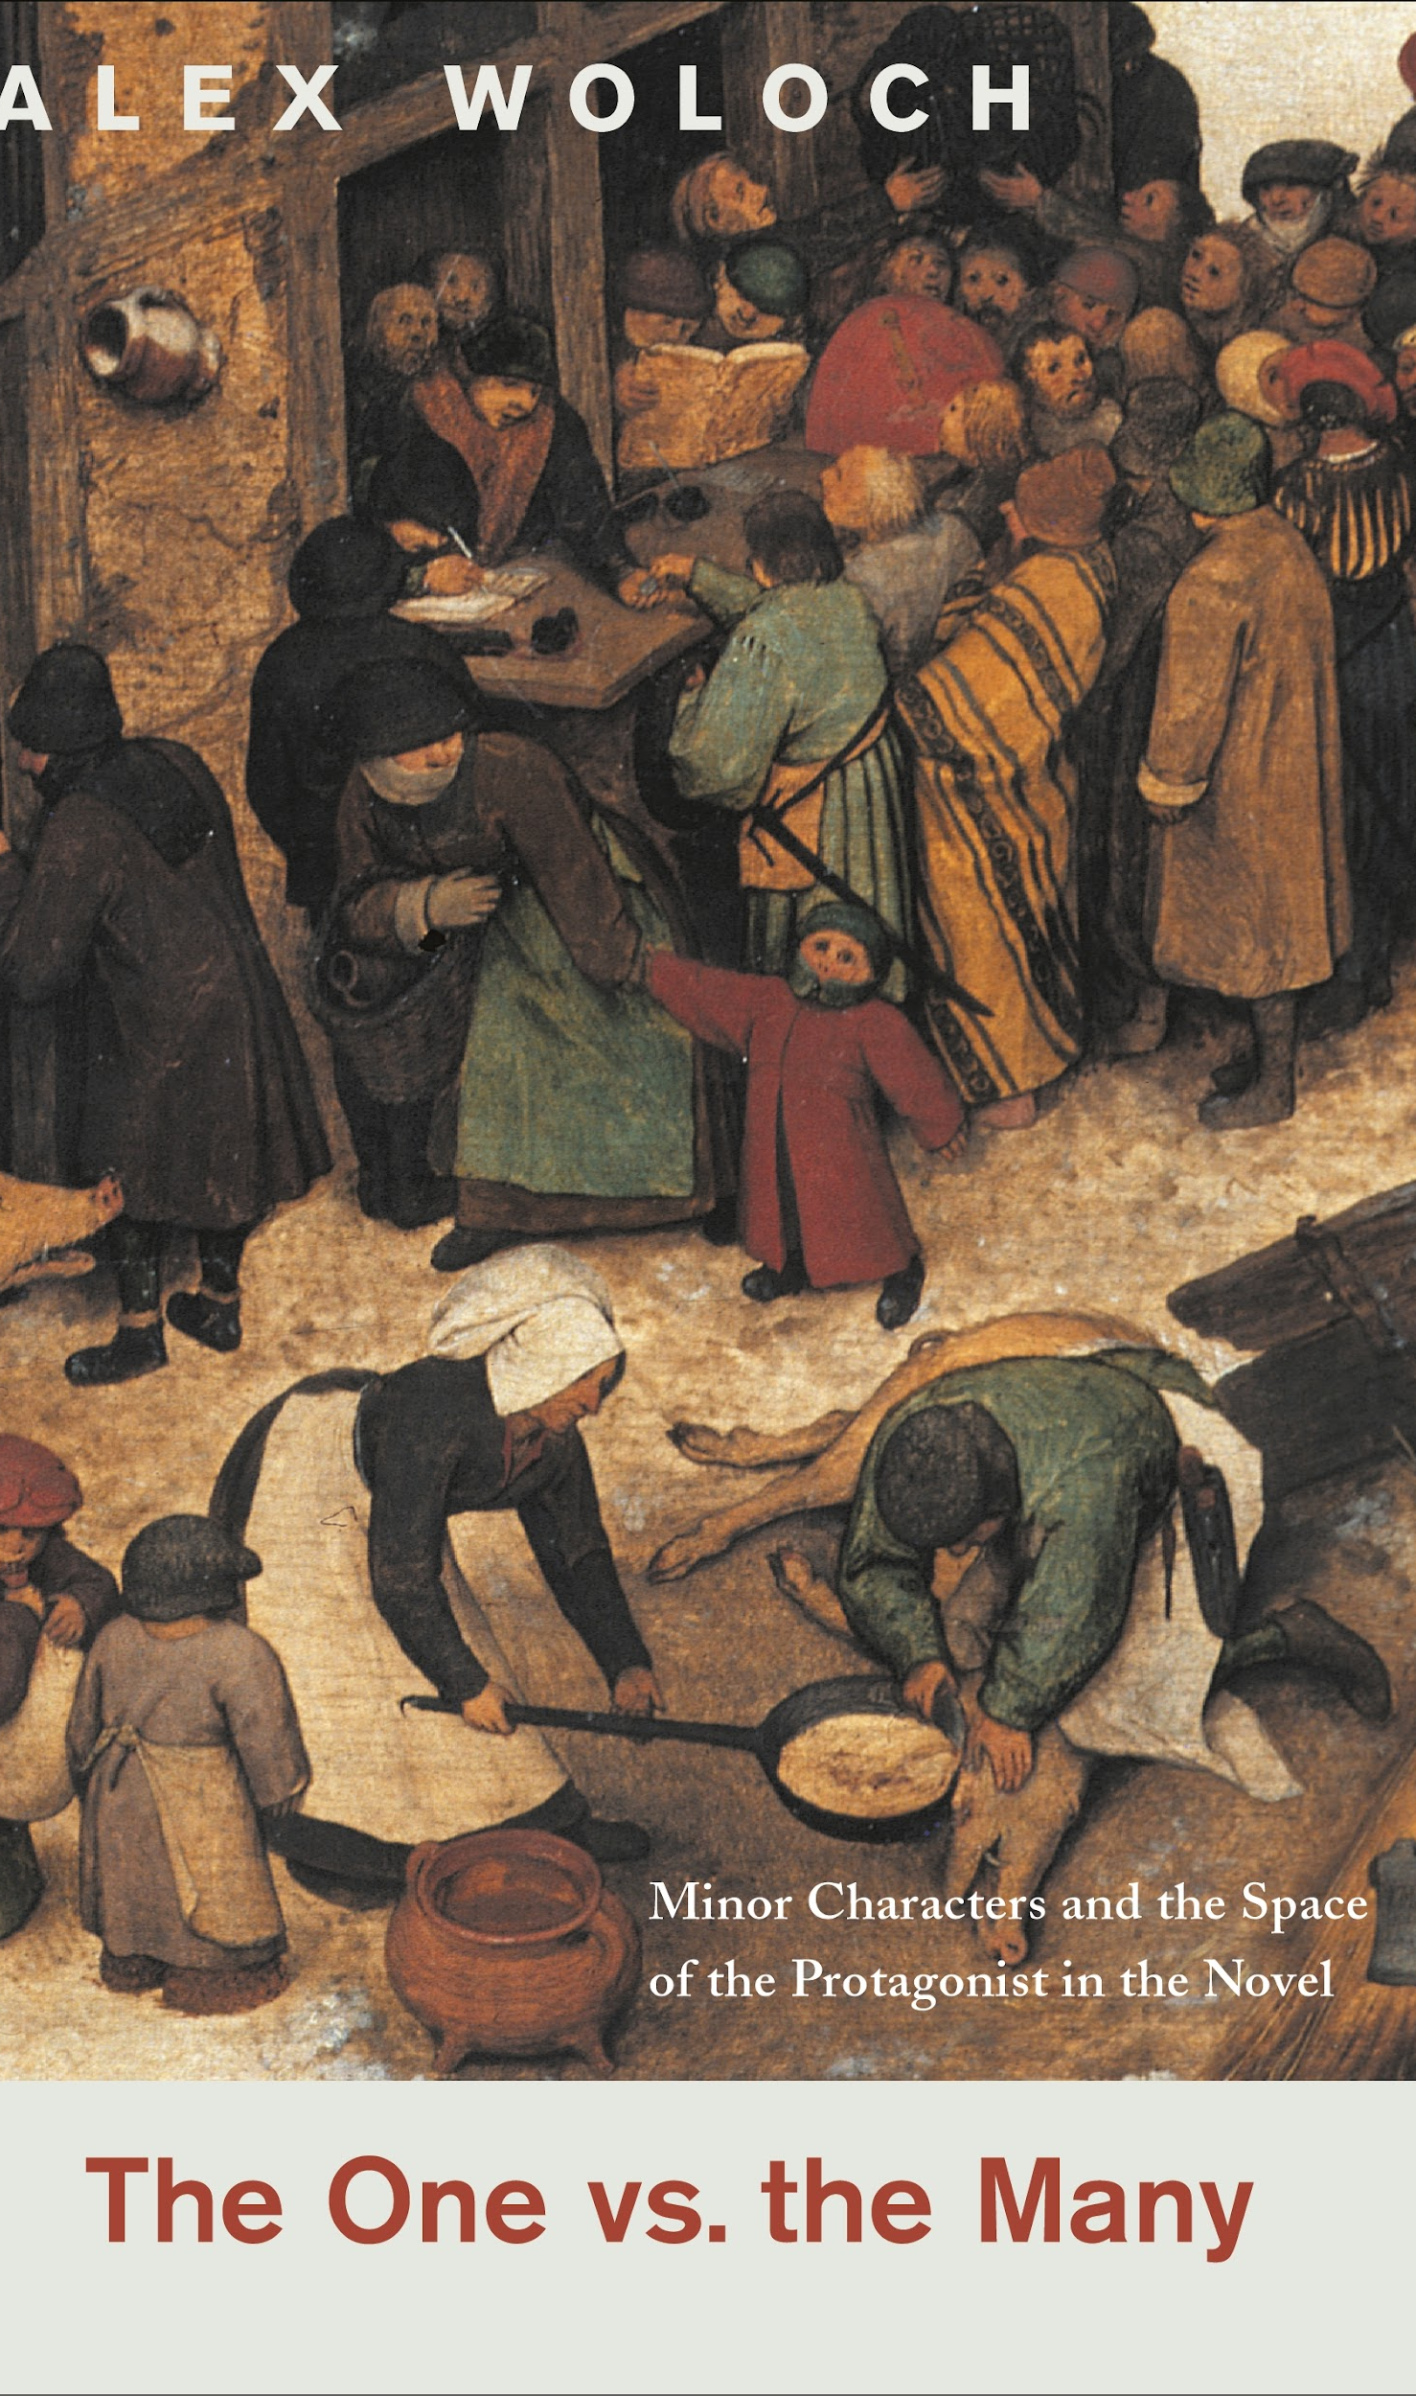
The Concept of Narrative Asymmetry
To locate the asymmetry, we can ask a basic question: if Pride & Prejudice focuses on Elizabeth Bennet because she is the most interesting and complicated character, as most critics would argue, how do we account for the lingering presence of the Bennet sisters?
Elizabeth’s sisters are a continual presence in the novel: they are a constitutive part of the symbolic structure itself, despite or, as I want to argue, because of their Minorness.
- One vs the Many by Alex Woloch

Slide 8
Character
All of [Pride and Prejudice’s] examples illustrate two different conceptions of character that coexist within Jane Austen: character as social being (a person is a character) and character as inner quality (a person has a character). The narrative structure that mediates between them is precisely asymmetry. Austen famously transforms the novel into a genre that abstracts elucidates, and diagnoses human characteristics: facilitating contrasts between inner qualities like “observation” and “temper.”
One vs the Many – Alex Woloch

Slide 9
Character defined by the OED
Moral and mental qualities strongly developed or strikingly displayed; distinct or distinguished personality.
The sum of the moral and mental qualities which distinguish an individual or a people, viewed as a homogeneous whole; a person's or group's individuality deriving from environment, culture, experience, etc.; mental or moral constitution, personality.
Personality, esp. strong personality, as suggested by an aspect of a person's appearance, or in a representation of a person.

Slide 10
Thoughts on Keymer?

Slide 11
Keymer, On Rank
Mr Elliot’s bland assertion that ‘rank is rank’ makes plain the gulf between Jane Austen’s characters and first audience, for whom rank is an intricate but self-evident system of social organism and signification, and modern readers, for whom the nuances and gradations of the system are often obscure (387)
Social position is of consuming importance in the novels, with individuals and families measuring their relative standings to the finest degree while devising long-term strategies for advancement in status (387)
Yet these concerns are articulated in terms predating the class-based language of politics that grew up among radicals

Slide 12
Keymer, On Rank
The term, ‘class’ was already current by Austen’s day - P.J. Corfield cites a writer of 1753 who itemised English society in ‘five Classes; viz. the Nobility, the Gentry, the genteel Trades, the common Trades, and the Peasantry
‘Rank remained the established model, and dictated conventional thought
Where ‘class’ would be measured in terms above all of productivity and income, locating individuals in socio-economic positions attained through material success, ‘rank’ placed primarily emphasis on lineage, implying that social status was more or less inalienably conferred by birth and descent (387)
Where ‘class’ brings with it overtones of structural antagonism and conflicts, moreover, ‘rank’ suggested stratifications that were harmonious, orderly and stable - ranks being nothing if not serried

Slide 13
Keymer, On Rank
As exponents of genre specializing in close and particular renderings of social reality, few novelists of Austen’s day fail to register the defining importance of rank.
Yet it is hard to think of a contemporary or precursor in whose fiction there is quite so thorough an immersion in, and calibration of, the minutiae of the system
The eighteenth century novelist most admired by Jane Austen, Samuel Richardson, wrote innovatively about emerging fault-lines in the strata of rank, and in Pamela (1740) - in which a maid servant wings her master’s hand - he pioneered the plot of marital elevation that Austen was to use herself in more muted for.

Slide 14
Keymer, On Rank
Jane Austen, by contrast, was native to this world, and writes with unfailing alertness to its codes and conventions
Though relatively disadvantaged in financial terms, Jane Austen’s family could boast aristocratic descent and ongoing connections, and if anything the lack of corresponding wealth enhanced the obsession with rank in her immediate circle (388)
In each novel, ‘neighbourhood’ is a feature of both the landscape and its elite population.
It denotes both the hierarchy of estates and manors that revolved around the local great house, and the rural gentry who inhabited these places, where they competed for visits from, and invitations to, houses on the level above, and made seasonal forays to London or Bath in pursuit of extended connection.

Slide 15
Keymer, On Rank (Thoughts)
Pamela vs Pride & Prejudice
Pamela = eccentric [pays attention to it / her confusion as opposed to society]
Pride & Prejudice = formality [hyper aware of rank]
Austen acknowledges that the characters are all aware of rank & they keep mentioning it
Darcy is aware of rank [lack of rank → thinks of Elizabeth’s family rank] → goes to the degree of influencing Mr. Bingley
Elizabeth is also aware of the rank / (Mr. Darcy vs Mr. Collins)
City vs Country – the Country is very simple / Mr. Bingley → Charming
Bias to the countryside → because of their rank
Jane Austen → preserves her grandmother’s letter / and had a view of life because of her family relations
Charlotte → subversive in terms of rank, because she doesn’t care about his personality

Slide 16
Free Indirect Discourse (FID)
Free indirect discourse (FID) is a narrative technique in which the narrator’s third-person voice is infused with the first-person voice of the character without indicators, such as "she said" or "I thought.
The narrator has access to the thoughts and feelings of the characters and describes these to the reader. The narrator of the novel also frequently adds commentary about characters and their actions, which shapes the reader’s perception.
For example, at the start of the novel the narrator describes Mrs. Bennet as “a woman of mean understanding, little information, and uncertain temper.” Although the narrator has access to every character’s interior life, the novel’s events are usually told from Elizabeth’s point of view.

Slide 17
Effect of the FID
gossipy best friend = narrator
get part of the inside world
goes into the story
pulling the curtain back → familiar background in the polite society
how stories would be told verbally vs formal world
anecdotes

Slide 18
Group Discussion

Slide 19
Important passages

Slide 20
Miss Bingley
Miss Bingley’s attention was quite as much engaged in watching Mr. Darcy’s progress through his book, as in reading her own; and she was perpetually either making some inquiry, or looking at his page. She could not win him, however, to any conversation; he merely answered her question and read on. At length, quite exhausted by the attempt to be amused with her own book, which she had only chosen because it was the second volume of his, she gave a great yawn and said, “How pleasant it is to spend an evening in this way! I declare, after all, there is no enjoyment like reading! How much sooner one tires of anything than of a book! When I have a house of my own, I shall be miserable if I have not an excellent library (54, oxford p.41)
Discussion Question: Why does the author characterize Miss Bingley in this way? How does it contrast to Elizabeth?

Slide 21
Darcy & Elizabeth
I am perfectly convinced by it that Mr. Darcy has no defect. He owns it himself without disguise.”
“No,” said Darcy, “I have made no such pretension. I have faults enough, but they are not, I hope, of understanding. My temper I dare not vouch for. It is, I believe, too little yielding; certainly too little for the convenience of the world. I cannot forget the follies and vices of others so soon as I ought, nor their offences against myself. My feelings are not puffed about with every attempt to move them. My temper would perhaps be called resentful. My good opinion once lost is lost for ever.”
“That is a failing, indeed!” cried Elizabeth. “Implacable resentment is a shade in a character. But you have chosen your fault well. I really cannot laugh at it. You are safe from me.”
“There is, I believe, in every disposition a tendency to some particular evil, a natural defect, which not even the best education can overcome.”
“And your defect is a propensity to hate everybody.”
“And yours,” he replied, with a smile, “is wilfully to misunderstand them.” (57, Oxford p. 43 - 44)
Discussion Question: What is the effect of their banter? What is the author’s purpose?

Slide 22
Mr. Collins

Slide 23
Mr. Collins
Mr. Collins was punctual to his time, and was received with great politeness by the whole family. Mr. Bennet indeed said little; but the ladies were ready enough to talk, and Mr. Collins seemed neither in need of encouragement, nor inclined to be silent himself. He was a tall, heavy-looking young man of five-and-twenty. His air was grave and stately, and his manners were very formal. He had not been long seated before he complimented Mrs. Bennet on having so fine a family of daughters, said he had heard much of their beauty, but that, in this instance, fame had fallen short of the truth; and added, that he did not doubt her seeing them all in due time well disposed of in marriage. This gallantry was not much to the taste of some of his hearers; but Mrs. Bennet, who quarrelled with no compliments, answered most readily,— (63, Oxford p. 49)
Discussion Question: What ‘character’ is Mr. Collins?

Slide 24
Mr. Collins was not a sensible man
MR. COLLINS was not a sensible man, and the deficiency of nature had been but little assisted by education or society; the greatest part of his life having been spent under the guidance of an illiterate and miserly father; and though he belonged to one of the universities, he had merely kept the necessary terms without forming at it any useful acquaintance. The subjection in which his father had brought him up had given him originally great humility of manner; but it was now a good deal counteracted by the self-conceit of a weak head, living in retirement, and the consequential feelings of early and unexpected prosperity. A fortunate chance had recommended him to Lady Catherine de Bourgh when the living of Hunsford was vacant; and the respect which he felt for her high rank, and his veneration for her as his patroness, mingling with a very good opinion of himself, of his authority as a clergyman, and his right as a rector, made him altogether a mixture of pride and obsequiousness, self-importance and humility (69, Oxford p. 53)
Discussion Question: Whose point of view is Mr. Collins told from? And how does it contribute to the message of the book?

Slide 25
Proposal & Rejection
“You are too hasty, sir,” she cried. “You forget that I have made no answer. Let me do it without further loss of time. Accept my thanks for the compliment you are paying me. I am very sensible of the honour of your proposals, but it is impossible for me to do otherwise than decline them.”
“I am not now to learn,” replied Mr. Collins, with a formal wave of the hand, “that it is usual with young ladies to reject the addresses of the man whom they secretly mean to accept, when he first applies for their favour; and that sometimes the refusal is repeated a second or even a third time. I am, therefore, by no means discouraged by what you have just said, and shall hope to lead you to the altar ere long.”
“Upon my word, sir,” cried Elizabeth, “your hope is rather an extraordinary one after my declaration. I do assure you that I am not one of those young ladies (if such young ladies there are) who are so daring as to risk their happiness on the chance of being asked a second time. I am perfectly serious in my refusal. You could not make me happy, and I am convinced that I am the last woman in the world who would make you so. Nay, were your friend Lady Catherine to know me, I am persuaded she would find me in every respect ill qualified for the situation.” (104, Oxford p. 81 - 82)
Discussion Question:What kind of language do the two use to communicate their misunderstandings?

Slide 26
Clothing
“Do not make yourself uneasy, my dear cousin, about your apparel. Lady Catherine is far from requiring that elegance of dress in us which becomes herself and daughter. I would advise you merely to put on whatever of your clothes is superior to the rest—there is no occasion for anything more. Lady Catherine will not think the worse of you for being simply dressed. She likes to have the distinction of rank preserved.” (p.158, Oxford p.121)
Discussion Question: Why is Mr. Collins depicted in this way?
society and class, what he thinks is consistent

Slide 27
Disapproval of Marriage

Slide 28
The Marriage Market
Mr. Wickham was the happy man towards whom almost every female eye was turned, and Elizabeth was the happy woman by whom he finally seated himself; and the agreeable manner in which he immediately fell into conversation, though it was only on its being a wet night, and on the probability of a rainy season, made her feel that the commonest, dullest, most threadbare topic might be rendered interesting by the skill of the speaker.
With such rivals for the notice of the fair as Mr. Wickham and the officers, Mr. Collins seemed to sink into insignificance; to the young ladies he certainly was nothing; but he had still at intervals a kind listener in Mrs. Philips, and was, by her watchfulness, most abundantly supplied with coffee and muffin.
When the card tables were placed, he had an opportunity of obliging her, in return, by sitting down to whist.
“I know little of the game at present,” said he, “but I shall be glad to improve myself; for in my situation of life——” Mrs. Philips was very thankful for his compliance, but could not wait for his reason.
Mr. Wickham did not play at whist, and with ready delight was he received at the other table between Elizabeth and Lydia. At first there seemed danger of Lydia’s engrossing him entirely, for she was a most determined talker; but being likewise extremely fond of lottery tickets, she soon grew too much interested in the game, too eager in making bets and exclaiming after prizes, to have attention for anyone in particular. Allowing for the common demands of the game, Mr. Wickham was therefore at leisure to talk to Elizabeth, and she was very willing to hear him, though what she chiefly wished to hear she could not hope to be told, the history of his acquaintance with Mr. Darcy. She dared not even mention that gentleman. Her curiosity, how ever, was unexpectedly relieved. Mr. Wickham began the subject himself. He inquired how far Netherfield was from Meryton; and, after receiving her answer, asked in a hesitating manner how long Mr. Darcy had been staying there. (75, Oxford p. 57 - 58)
Discussion Question:In what ways does the scene seem humorous and yet, also a commentary on the marriage market?
couple characters → contrast between Mr. Collins & Mr. Wickham [marriage]
Mrs. Phillips → polite to Mr. Collins / let a breath of air out

Slide 29
Reasons for Marriage
“My reasons for marrying are, first, that I think it a right thing for every clergyman in easy circumstances (like myself) to set the example of matrimony in his parish; secondly, that I am convinced it will add very greatly to my happiness; and, thirdly, which perhaps I ought to have mentioned earlier, that it is the particular advice and recommendation of the very noble lady whom I have the honour of calling patroness. Twice has she condescended to give me her opinion (unasked too!) on this subject; and it was but the very Saturday night before I left Hunsford,—between our pools at quadrille, while Mrs. Jenkinson was arranging Miss De Bourgh’s footstool,—that she said, ‘Mr. Collins, you must marry. A clergyman like you must marry. Choose properly, choose a gentlewoman for my sake, and for your own; let her be an active, useful sort of person, not brought up high, but able to make a small income go a good way. This is my advice. Find such a woman as soon as you can, bring her to Hunsford, and} I will visit her.’ Allow me, by the way, to observe, my fair cousin, that I do not reckon the notice and kindness of Lady Catherine de Bourgh as among the least of the advantages in my power to offer. You will find her manners beyond anything I can describe; and your wit and vivacity, I think, must be acceptable to her, especially when tempered with the silence and respect which her rank will inevitably excite. Thus much for my general intention in favour of matrimony; it remains to be told why my views were directed to Longbourn instead of my own neighbourhood, where I assure you there are many amiable young women. But the fact is, that being, as I am, to inherit this estate after the death of your honoured father (who, however, may live many years longer), I could not satisfy myself without resolving to choose a wife from among his daughters, that the loss to them might be as little as possible when the melancholy event takes place—which, however, as I have already said, may not be for several years. This has been my motive, my fair cousin, and I flatter myself it will not sink me in your esteem. And now nothing remains for me but to assure you in the most animated language of the violence of my affection. To fortune I am perfectly indifferent, and shall make no demand of that nature on your father, since I am well aware that it could not be complied with; and that one thousand pounds in the 4 per cents., which will not be yours till after your mother’s decease, is all that you may ever be entitled to. On that head, therefore, I shall be uniformly silent: and you may assure yourself that no ungenerous reproach shall ever pass my lips when we are married.”
It was absolutely necessary to interrupt him now. (103, Oxford p. 80 -81)
Discussion Question:What do you make of the long proposal? How is Mr. Collins character interpreted?
doesn’t really care about Elizabeth / necessity

Slide 30
Elizabeth & Mr. Collins
Mr. Collins = seems like he’s reading guidelines/book
Elizabeth = says what she thinks / feels
I am perfectly serious in my refusal
I am convinced that I am the last woman in the world who would make you so

Slide 31
Charlotte & Mr. Collins - Speedy Marriage
Her reflections were in general satisfactory. Mr. Collins, to be sure, was neither sensible nor agreeable: his society was irksome, and his attachment to her must be imaginary. But still he would be her husband. Without thinking highly either of men or of matrimony, marriage had always been her object: it was the only honourable provision for well-educated young women of small fortune, and, however uncertain of giving happiness, must be their pleasantest preservative from want. This preservative she had now obtained; and at the age of twenty-seven, without having ever been handsome, she felt all the good luck of it. The least agreeable circumstance in the business was the surprise it must occasion to Elizabeth Bennet, whose friendship she valued beyond that of any other person. Elizabeth would wonder, and probably would blame her; and though her resolution was not to be shaken, her feelings must be hurt by such a disapprobation. She resolved to give her the information herself; and therefore charged Mr. Collins, when he returned to Longbourn to dinner, to drop no hint of what had passed before any of the family. A promise of secrecy was of course very dutifully given, but it could not be kept without difficulty; for the curiosity excited by his long absence burst forth in such very direct questions on his return, as required some ingenuity to evade, and he was at the same time exercising great self-denial, for he was longing to publish his prosperous love (120, Oxford p.94)
Discussion Question: Why is this portion told in FID?

Slide 32
Elizabeth’s Thoughts on Marriage

Slide 33
Elizabeth’s Disapproval of Marriage
I have met with two instances lately: one I will not mention, the other is Charlotte’s marriage. It is unaccountable! in every view it is unaccountable!”
“My dear Lizzy, do not give way to such feelings as these. They will ruin your happiness. You do not make allowance enough for difference of situation and temper. Consider Mr. Collins’s respectability, and Charlotte’s prudent, steady character. Remember that she is one of a large family; that as to fortune it is a most eligible match; and be ready to believe, for everybody’s sake, that she may feel something like regard and esteem for our cousin.” (133, Oxford p. 102 - 103)
Discussion Question: In what ways are Elizabeth and Jane different in how they view marriage?
look at one’s character
Mr. and Mrs. Bennet → Mr. Bennet = Elizabeth is quick and intelligent / Mrs. Bennet = Jane’s pretty
Elizabeth = modern version of marriage / focused on happiness / can’t fathom that Collins can make her happy
Jane = typical model of marriage / this is a good match

Slide 34
Exploration
No scheme could have been more agreeable to Elizabeth, and her acceptance of the invitation was most ready and grateful. “My dear, dear aunt,” she rapturously cried, “what delight! what felicity! You give me fresh life and vigour. Adieu to disappointment and spleen. What are men to rocks and mountains? Oh, what hours of transport we shall spend! And when we do return, it shall not be like other travellers, without being able to give one accurate idea of anything. We will know where we have gone—we will recollect what we have seen. Lakes, mountains, and rivers, shall not be jumbled together in our imaginations; nor, when we attempt to describe any particular scene, will we begin quarrelling about its relative situation. Let our first effusions be less insupportable than those of the generality of travellers. (152, Oxford p.117)
Discussion Question: What kind of commentary is Austen giving on marriage?
take a break from the “marriage” drama
commentary on being bored to tears → marriage
more excited about the outdoors
{194

Slide 35
Lady Catherine

Slide 36
Lady Catherine
Lady Catherine was a tall, large woman, with strongly-marked features, which might once have been handsome. Her air was not conciliating, nor was her manner of receiving them such as to make her visitors forget their inferior rank. She was not rendered formidable by silence: but whatever she said was spoken in so authoritative a tone as marked her self-importance, and brought Mr. Wickham immediately to Elizabeth’s mind; and, from the observation of the day altogether, she believed Lady Catherine to be exactly what he had represented. (159, Oxford p.112)
Discussion Question: Why is Lady Catherine depicted to be so masculine?
dominating character
Mr. Collins is dominated by her
top dog of the situation
taking into consideration of her influence / high society / she knows it

Slide 37
Female Education
“No governess! How was that possible? Five daughters brought up at home without a governess! I never heard of such a thing. Your mother must have been quite a slave to your education.”
Elizabeth could hardly help smiling, as she assured her that had not been the case.
“Then who taught you? who attended to you? Without a governess, you must have been neglected.”
“Compared with some families, I believe we were; but such of us as wished to learn never wanted the means. We were always encouraged to read, and had all the masters that were necessary. Those who chose to be idle certainly might.”
“Ay, no doubt: but that is what a governess will prevent; and if I had known your mother, I should have advised her most strenuously to engage one. I always say that nothing is to be done in education without steady and regular instruction, and nobody but a governess can give it. It is wonderful how many families I have been the means of supplying in that way. I am always glad to get a young person well placed out. (p.161, Oxford p. 124 - 125)
Discussion Question: What do you see in the dynamics of how the two fight/argue?
doesn’t stand down to Lady Catherine
Education shows how society works / the fact that Elizabeth defies it [shows that Lady Catherine can comment on how she was taught]
Diss on Lady Catherine for being rude, despite being educated
Elizabeth = witty and intelligent
Pinnacle for on how women are / educated

